Slide 1
SEQUENTIAL CIRCUIT
SR LATCH

Slide 2
Youtube
https://www.youtube.com/watch?v=B5Z04JRHccE&t=580s&pbjreload=101

Slide 3
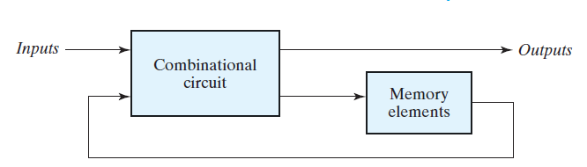
SEQUENTIAL CIRCUIT
Sequential circuit is a combination circuit with memory
Sequential circuit is specified by a time sequence of inputs, outputs, and internal states

Slide 4

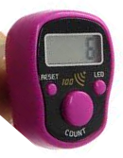

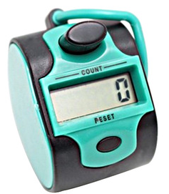
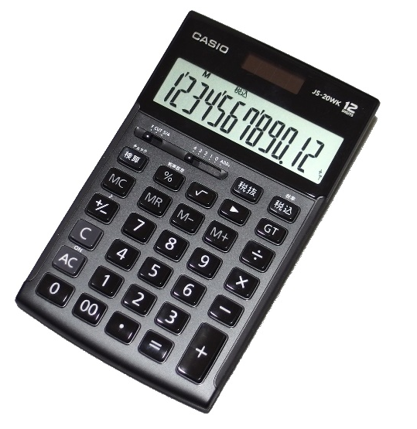
EXAMPLE SEQUENTIAL CIRCUIT

Slide 5
LATCH
Latch is a type of temporary storage device that has two stable states
Bistable
Multivibrator

Slide 6
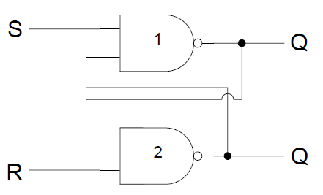
SR L ATCH

Slide 7
SR LATCH TABLE
0 | 0
0 | 1
1 | 0
1 | 1

Slide 8
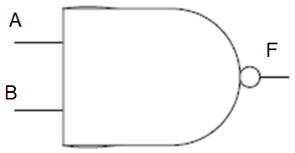
SR L ATCH
A | B | F
0 | 0 | 1
0 | 1 | 1
1 | 0 | 1
1 | 1 | 0

Slide 9
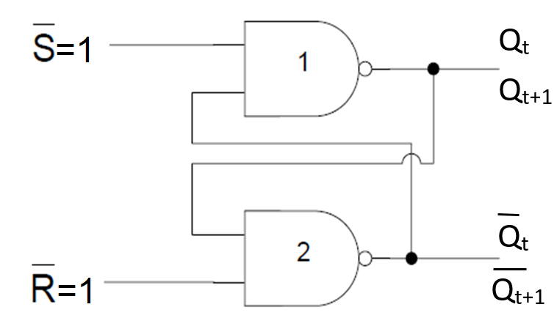
SR L ATCH
1 | 1

Slide 10
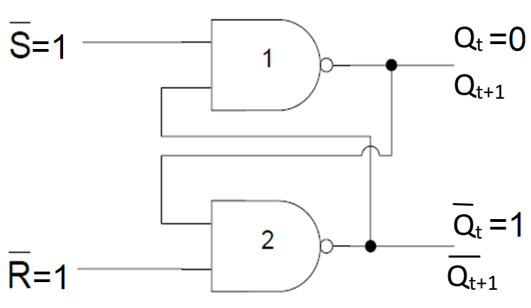
SR L ATCH
1 | 1

Slide 11
SR L ATCH
1 | 1 | 0 | 1

Slide 12
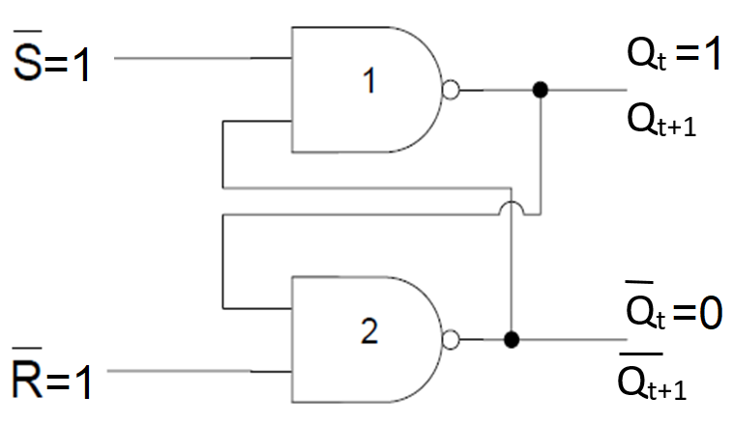
SR L ATCH
1 | 1

Slide 13
SR L ATCH
1 | 1 | 1 | 0

Slide 14
SR L ATCH
1 | 1
1 | 1

Slide 15
SR LATCH TABLE
0 | 0
0 | 1
1 | 0
1 | 1

Slide 16
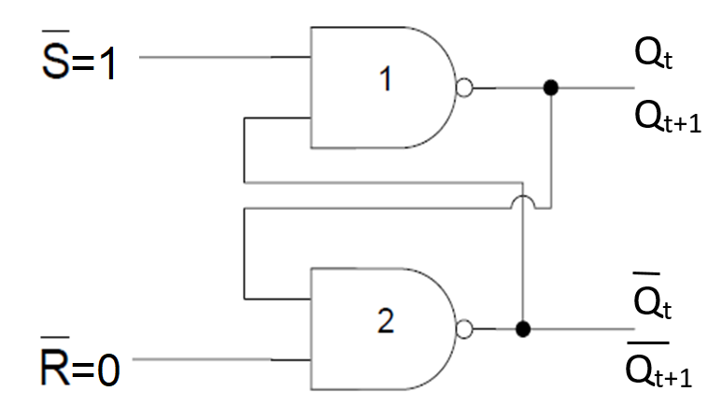
SR L ATCH
1 | 0

Slide 17
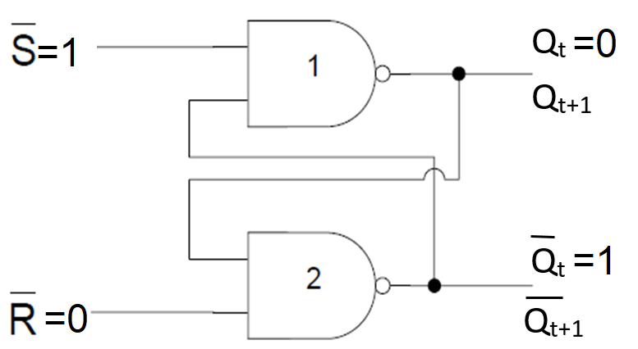
SR L ATCH
1 | 0

Slide 18
SR L ATCH
1 | 0 | 0 | 1

Slide 19
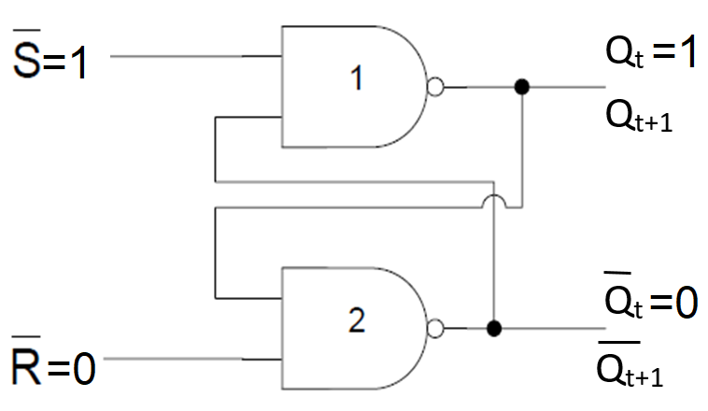
SR L ATCH
1 | 0

Slide 20
SR L ATCH
1 | 0 | 0 | 1

Slide 21
SR L ATCH
1 | 0 | 0 | 1
1 | 0 |  | 1

Slide 22
SR L ATCH
1 | 0 | 0 | 1
=
1 | 0 |  | 1

Slide 23
SR LATCH TABLE
0 | 0
0 | 1
1 | 0 | 0 | 1
1 | 1

Slide 24
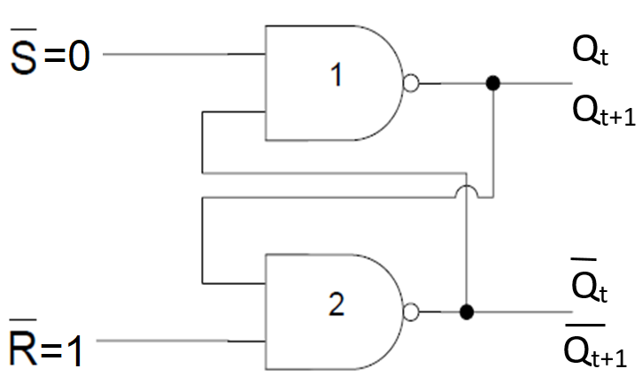
SR L ATCH
0 | 1

Slide 25
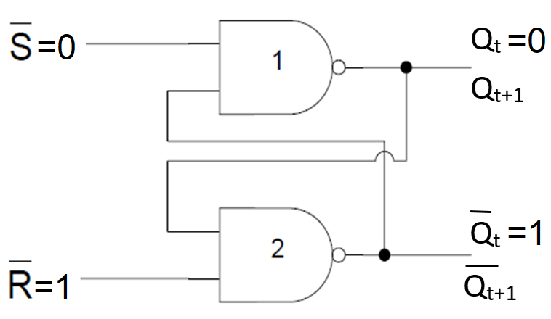
SR L ATCH
0 | 1

Slide 26
SR L ATCH
0 | 1 | 1 | 0

Slide 27
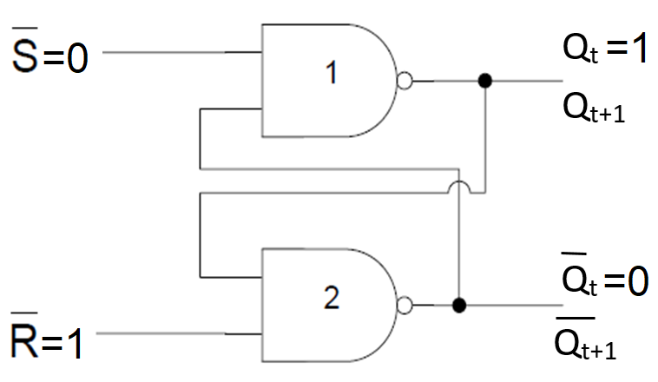
SR L ATCH
0 | 1

Slide 28
SR L ATCH
0 | 1 | 1 | 0

Slide 29
SR L ATCH
0 | 1 | 1 | 0
0 | 1 | 1 | 0

Slide 30
SR LATCH TABLE
0 | 0
0 | 1 | 1 | 0
1 | 0 | 0 | 1
1 | 1

Slide 31
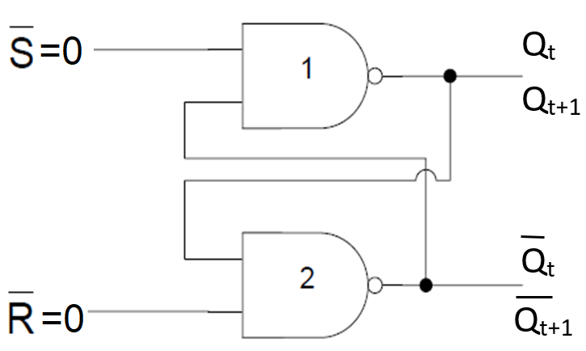
SR L ATCH
0 | 0

Slide 32
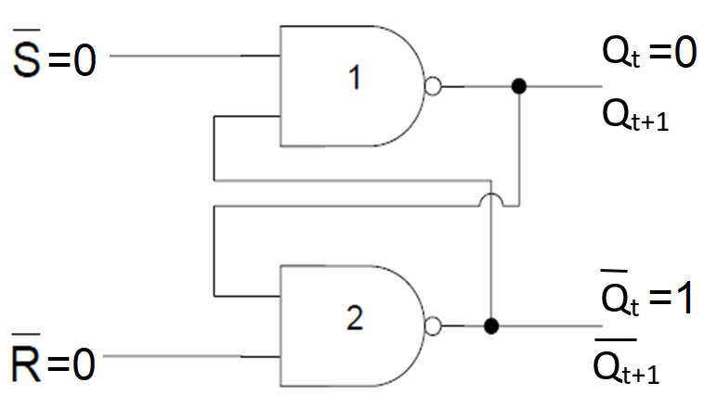
SR L ATCH
0 | 0

Slide 33
SR L ATCH
0 | 0 | 1 | 1

Slide 34
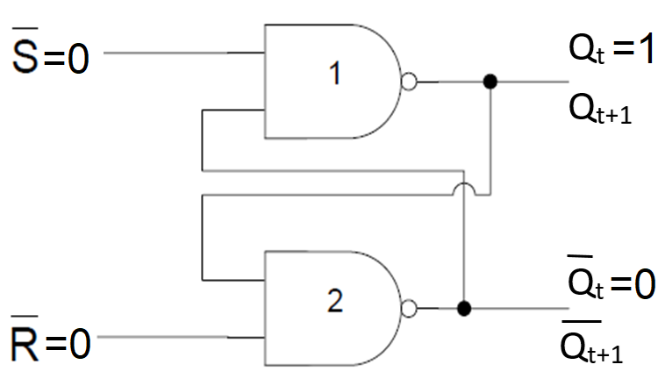
SR L ATCH
0 | 0

Slide 35
SR L ATCH
0 | 0 | 1 | 1

Slide 36
SR L ATCH
0 | 0 | 1 | 1
0 | 0 | 1 | 1

Slide 37
SR LATCH TABLE
0 | 0 | INVALID CONDITION
0 | 1 | 1 | 0
1 | 0 | 0 | 1
1 | 1

Slide 38
SR LATCH TABLE
 |  |  |  | COMMENT
0 | 0 | 1 | 1 | INVALID CONDITION
0 | 1 | 1 | 0 | SET
1 | 0 | 0 | 1 | RESET
1 | 1 |  |  | NO CHANGE

Slide 39
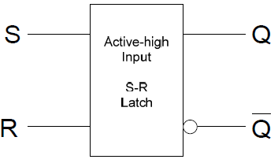
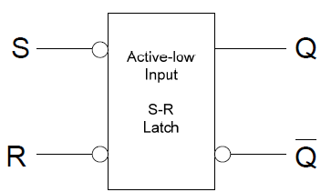
Logic Symbols

Slide 40
Logic Symbols

Slide 41
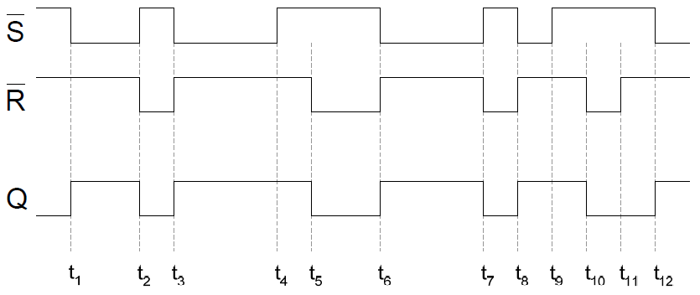
Timing diagrams

Slide 42
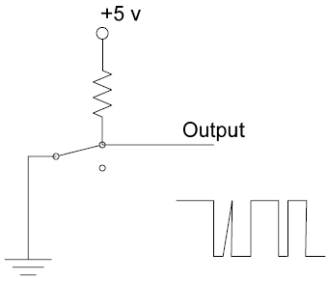
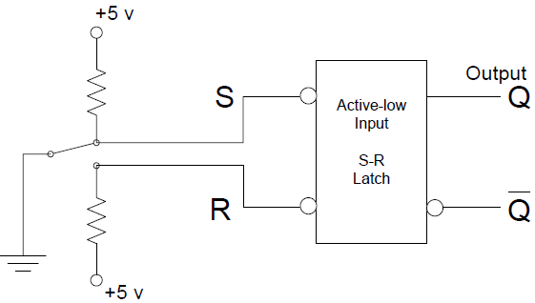
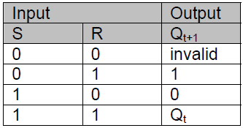
Latch Applications Switch ‘bounce’

Slide 43
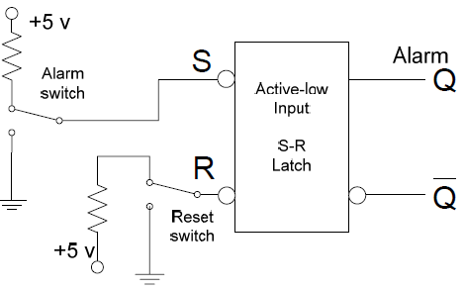
Latch Applications: Burglar Alarm

